Slide 1
MVPNet: Multi-View Point Regression Networks for 3D Object Reconstruction from A Single Image
Jinglu Wang¹, Bo Sun², Yan Lu¹
Microsoft Research Asia¹ Peking University²

Slide 2
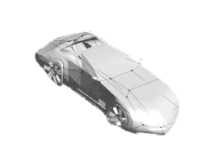
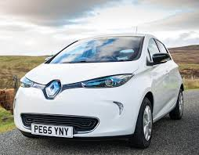
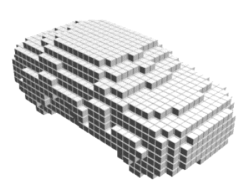
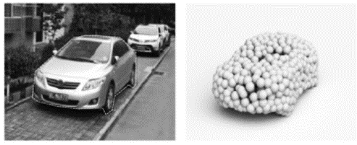
Representations for 3D Object Reconstruction
Mesh
Complete dense surface
Irregular structure -> Hard to train
Voxel
Regular grid-like structure
High cost for training
Hard to interpret surface
Point cloud
Simple representation
Not scalable for training
No correlation between points

Slide 3
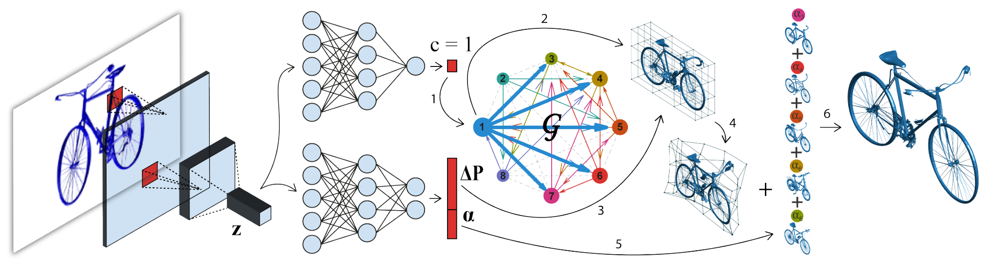
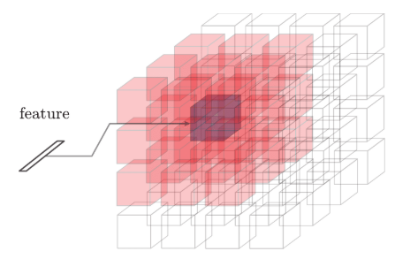
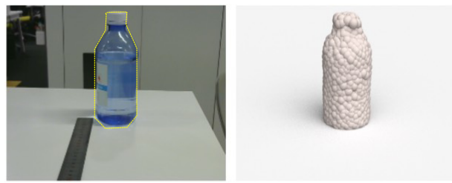
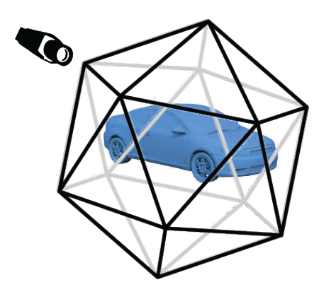
Related Work
Mesh based
Voxel based
Point based
Multi-view based
Template combination [CVPR 2017]
3D-R2N2 [ECCV 2016]
PSG [ICCV 2017]
Depth synthesis [CVPR 2017]

Slide 4

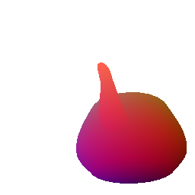
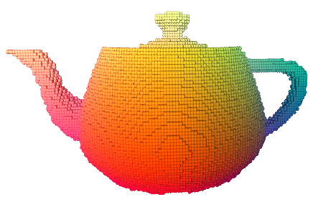
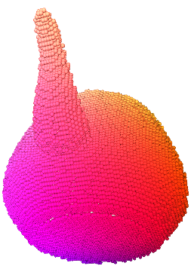
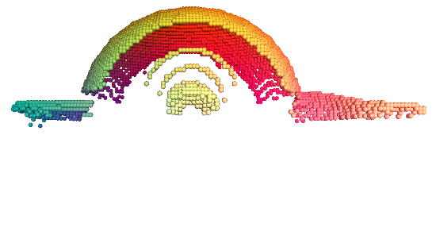
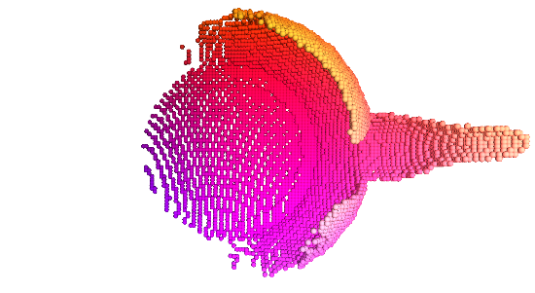
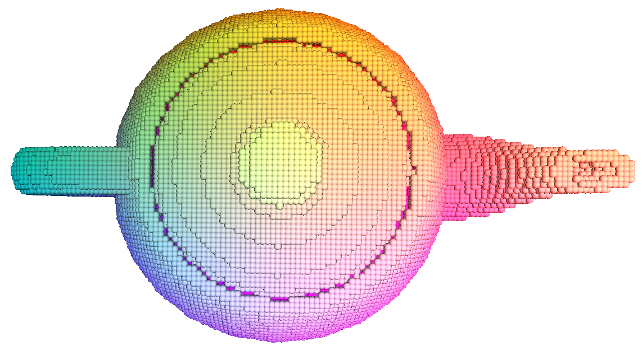
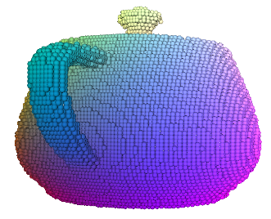
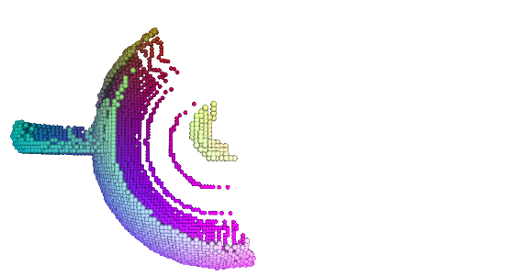
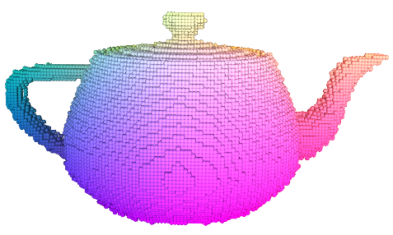
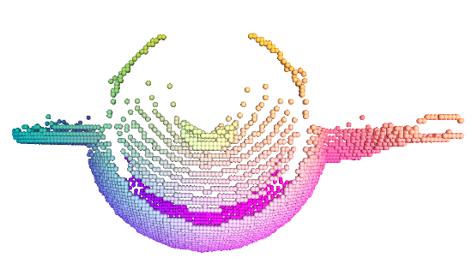
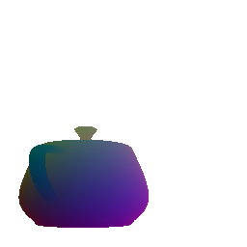

Multi-view Point Clouds
View 1
View 2
View 1
Top view
Top view
View 2
Top view
View 3
Top view
View 4
Top view
View 3
View 4

Slide 5
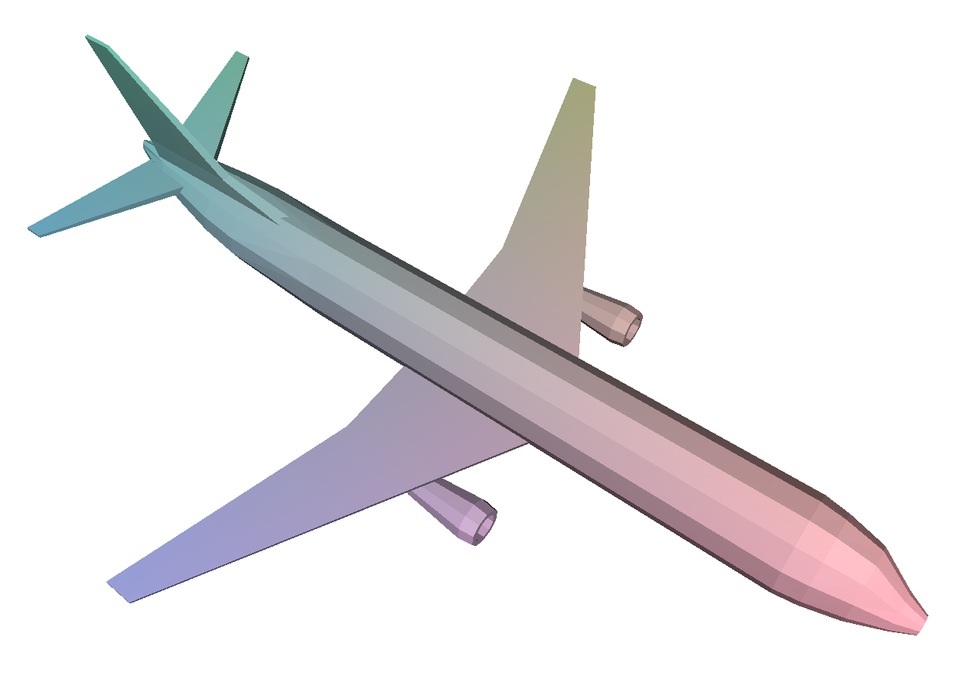
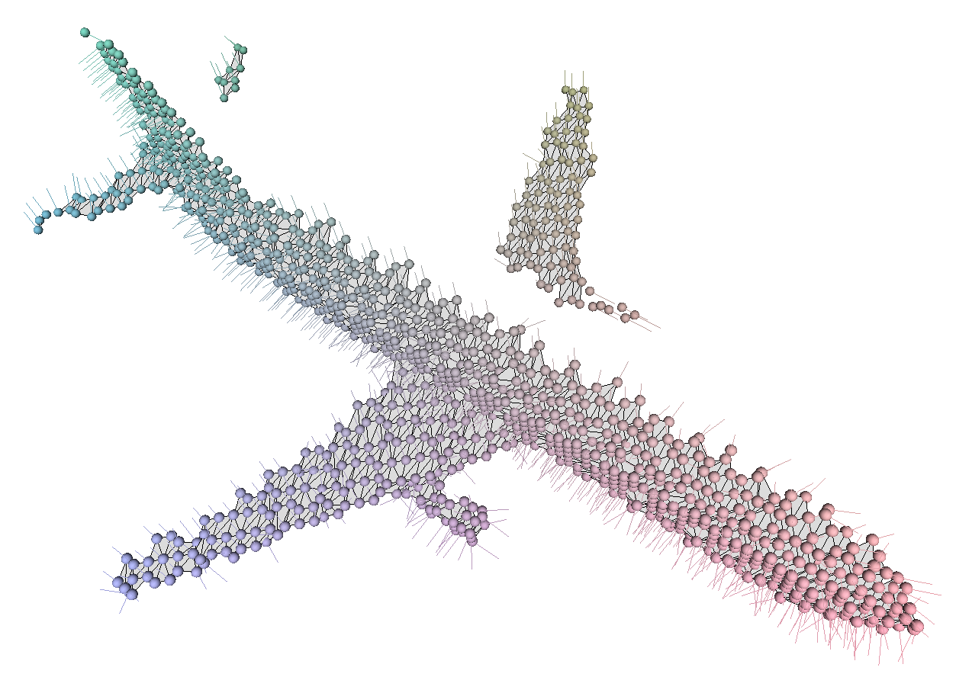
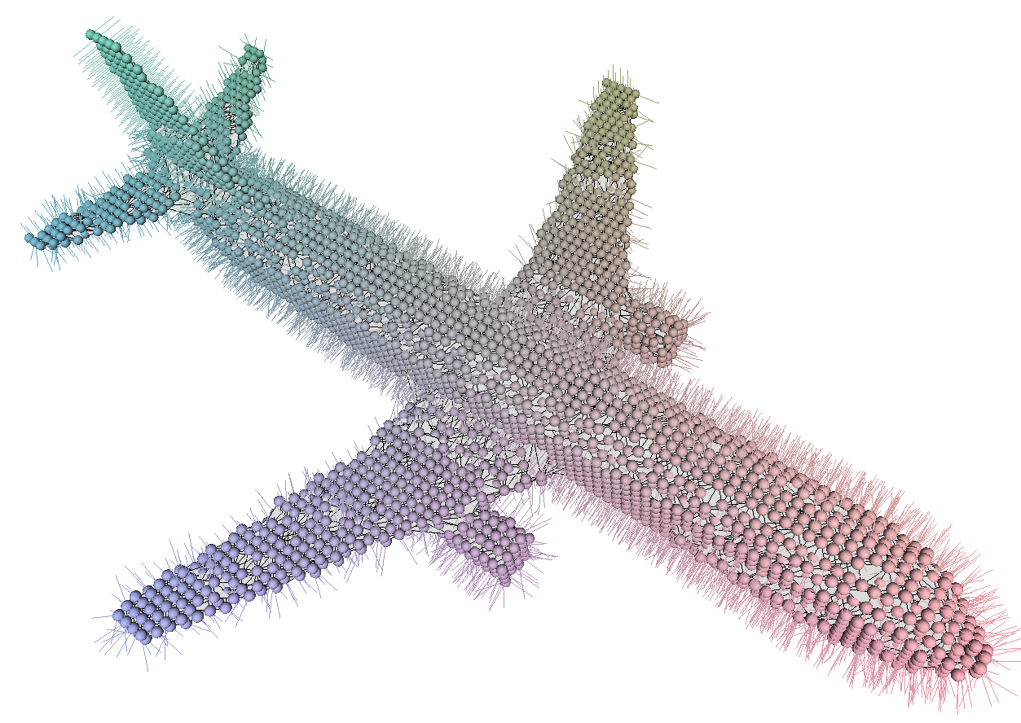



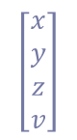
Multi-view Point Clouds
GT surface
2D Projection
GT 1-VPC
GT MVPC
View 1
N Views
View N
Triangulate
$$\left[\begin{matrix}x \\ y \\ z \\ v\end{matrix}\right]$$
View 2
Lift to 3D
2D grid
3D mesh

Slide 6
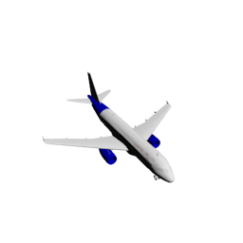
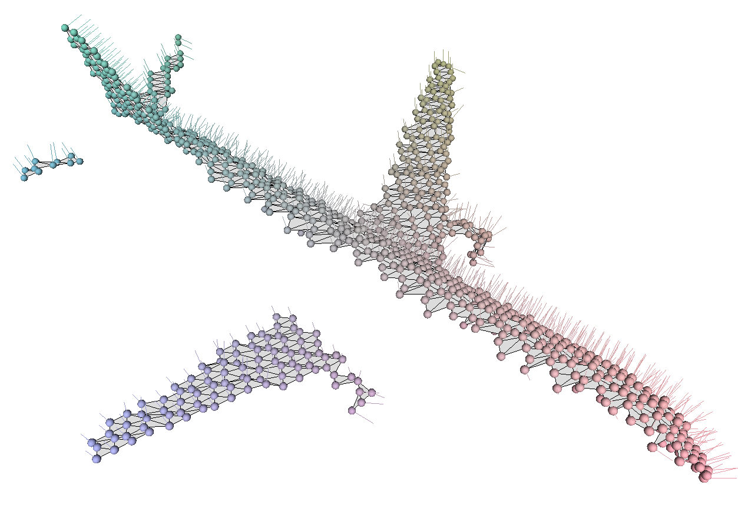
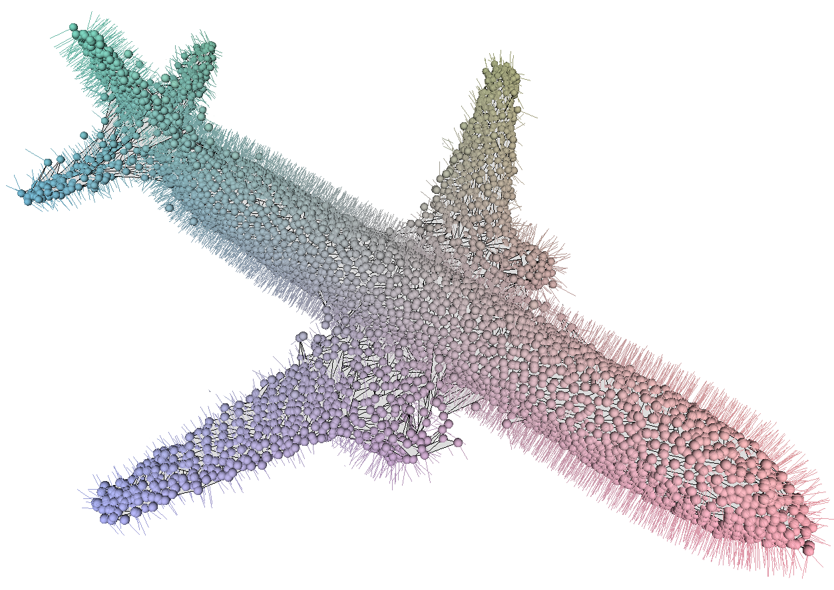
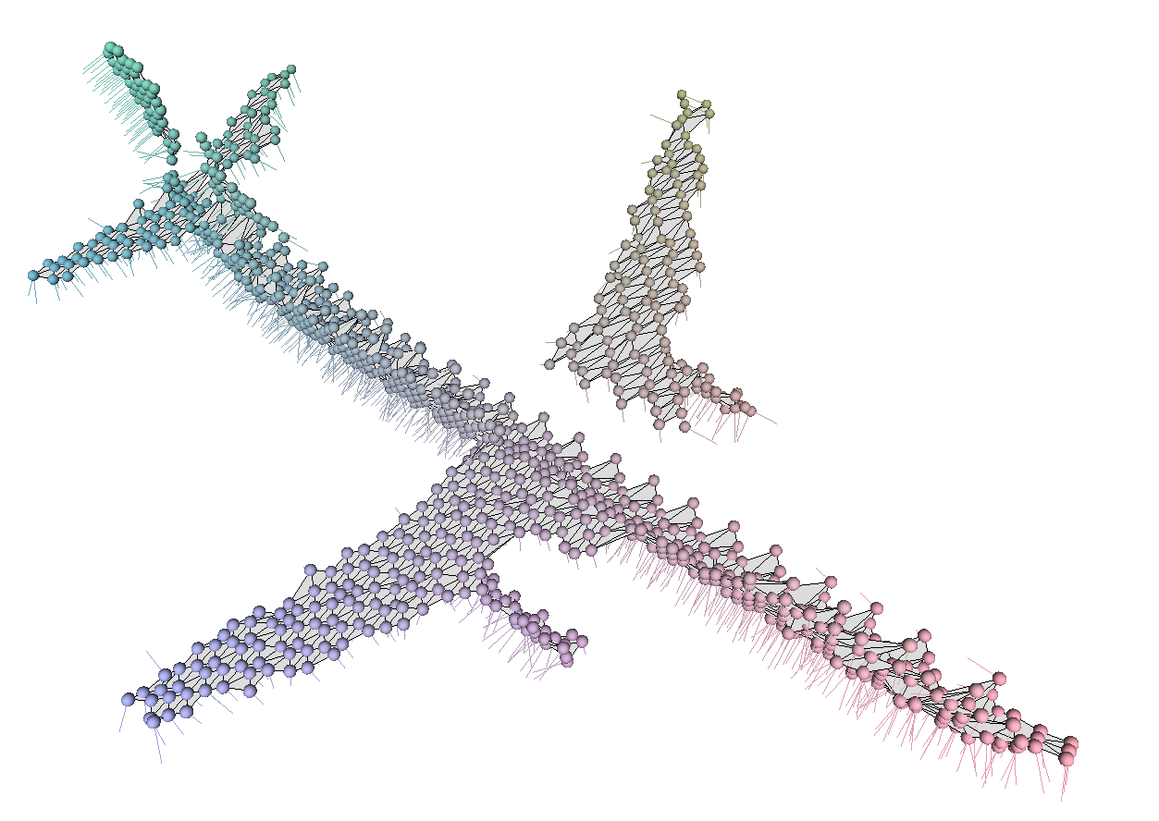
Multi-View Point Networks
Predicted 1-VPC
Triangulate
Input image
View 1
Lift to 3D
Predicted MVPC
MVPNet
View 2
View N
Geometric Loss
GT surface
View 1
2D Projection
GT 1-VPC
GT MVPC
View N
N Views
View 2

Slide 7
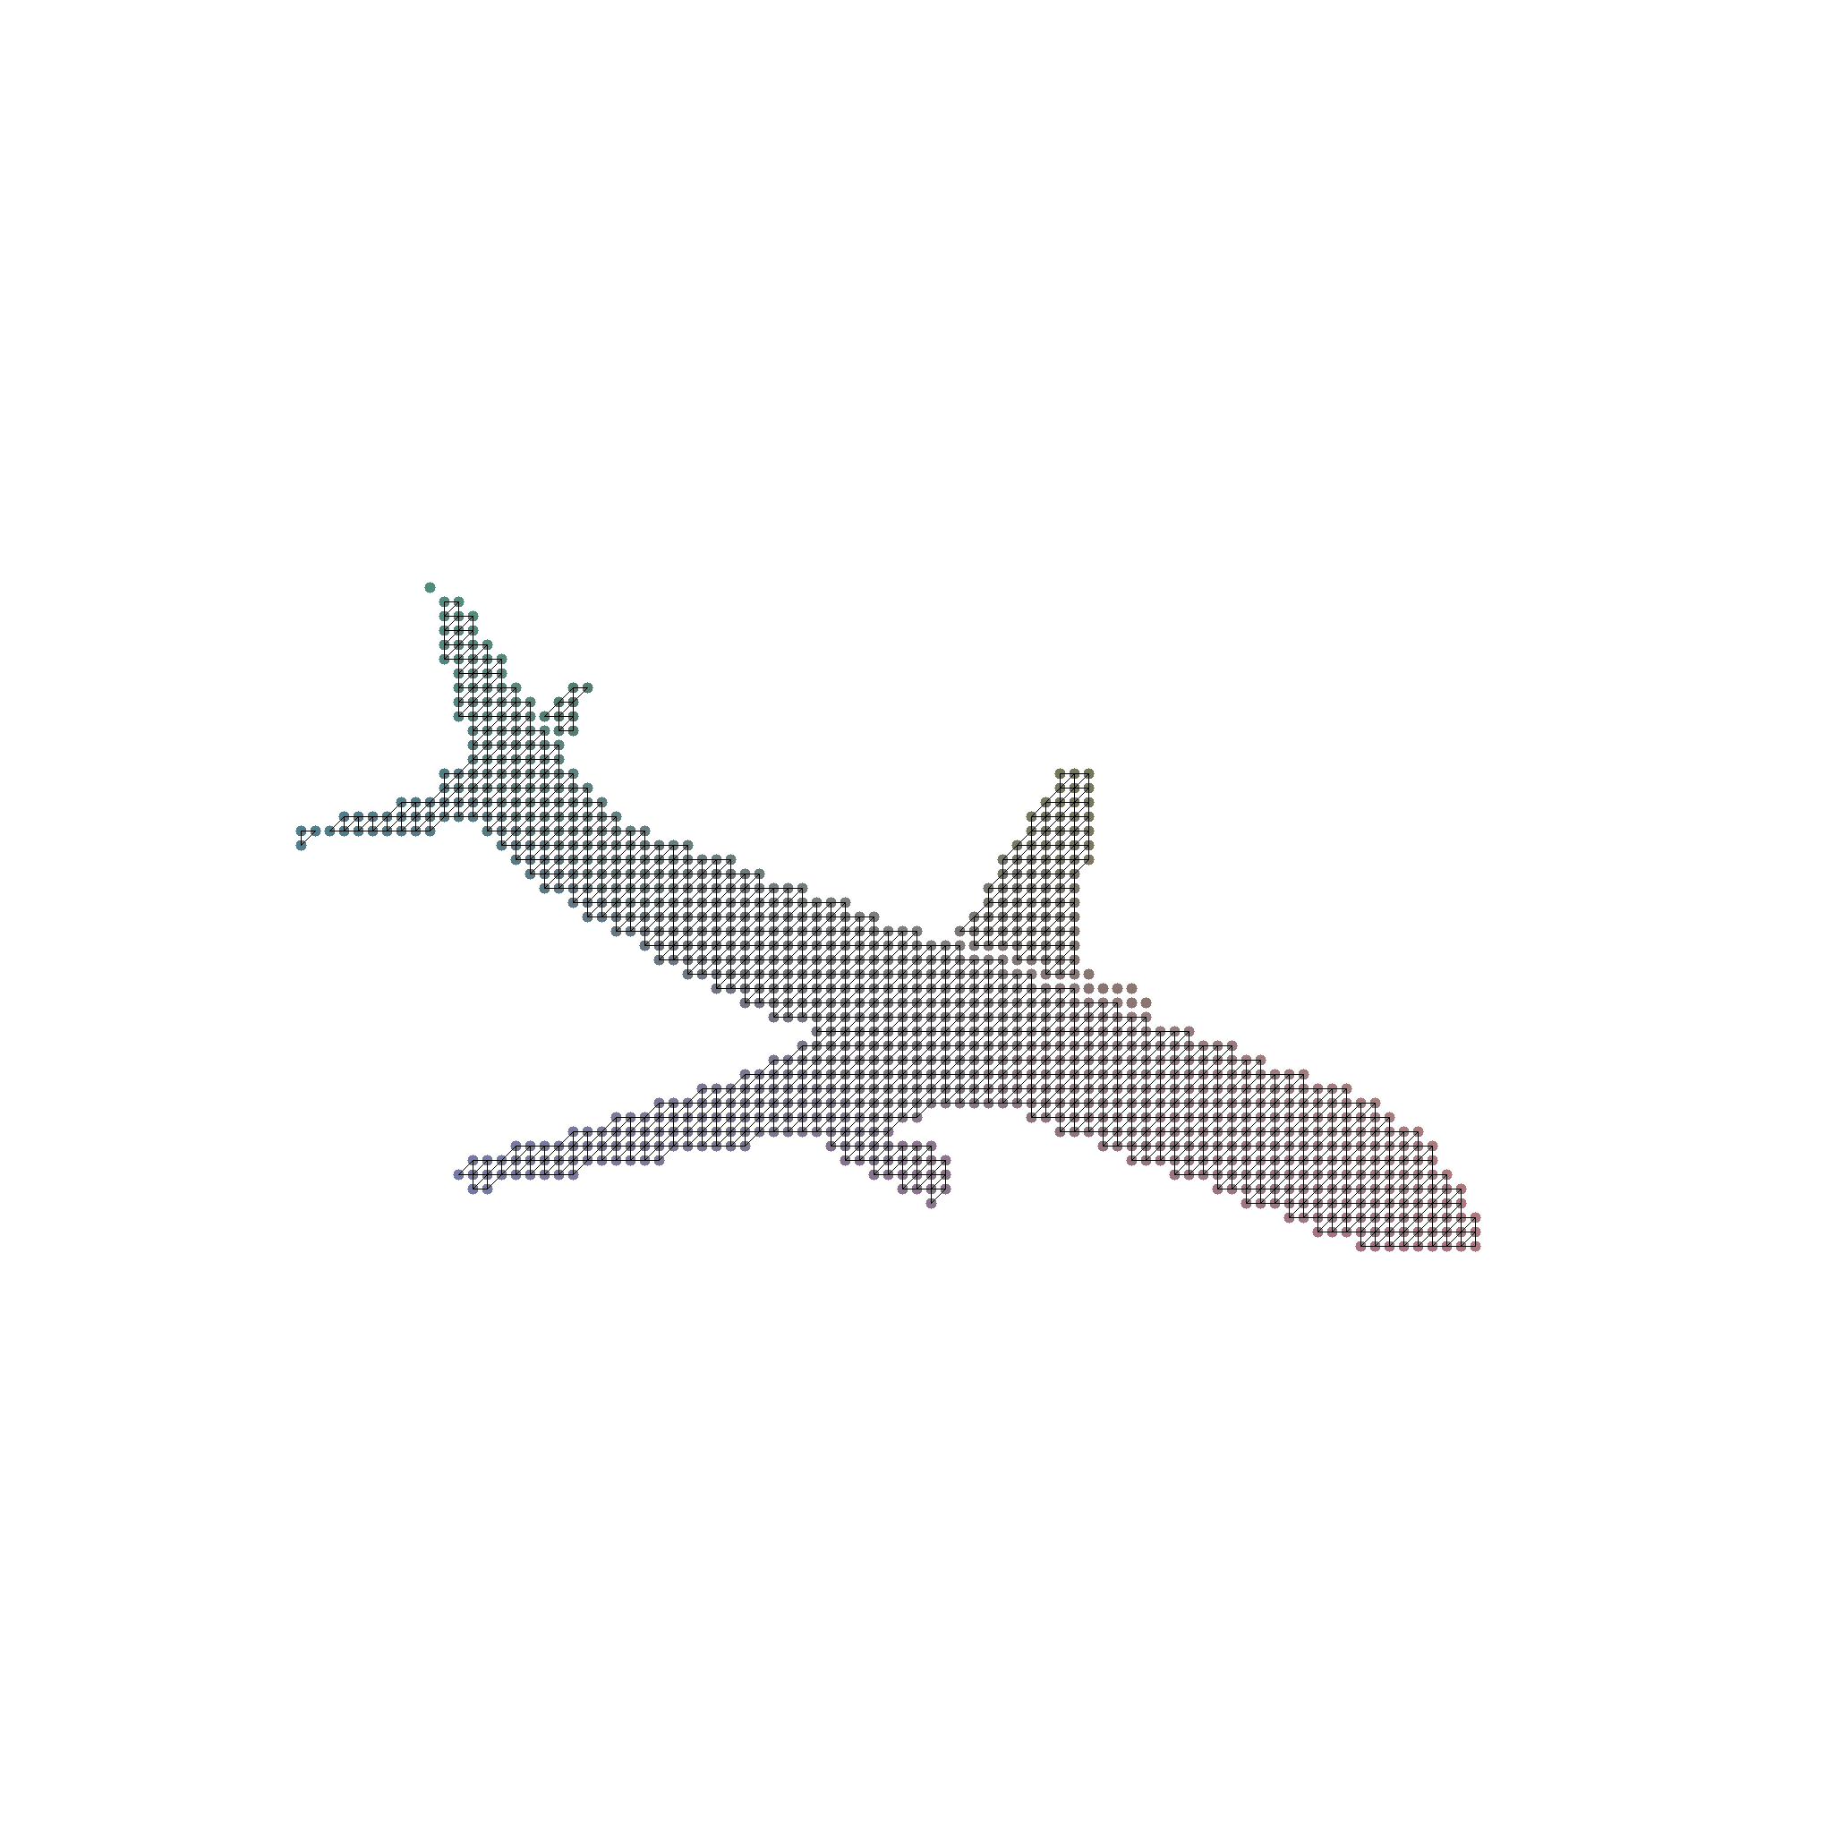


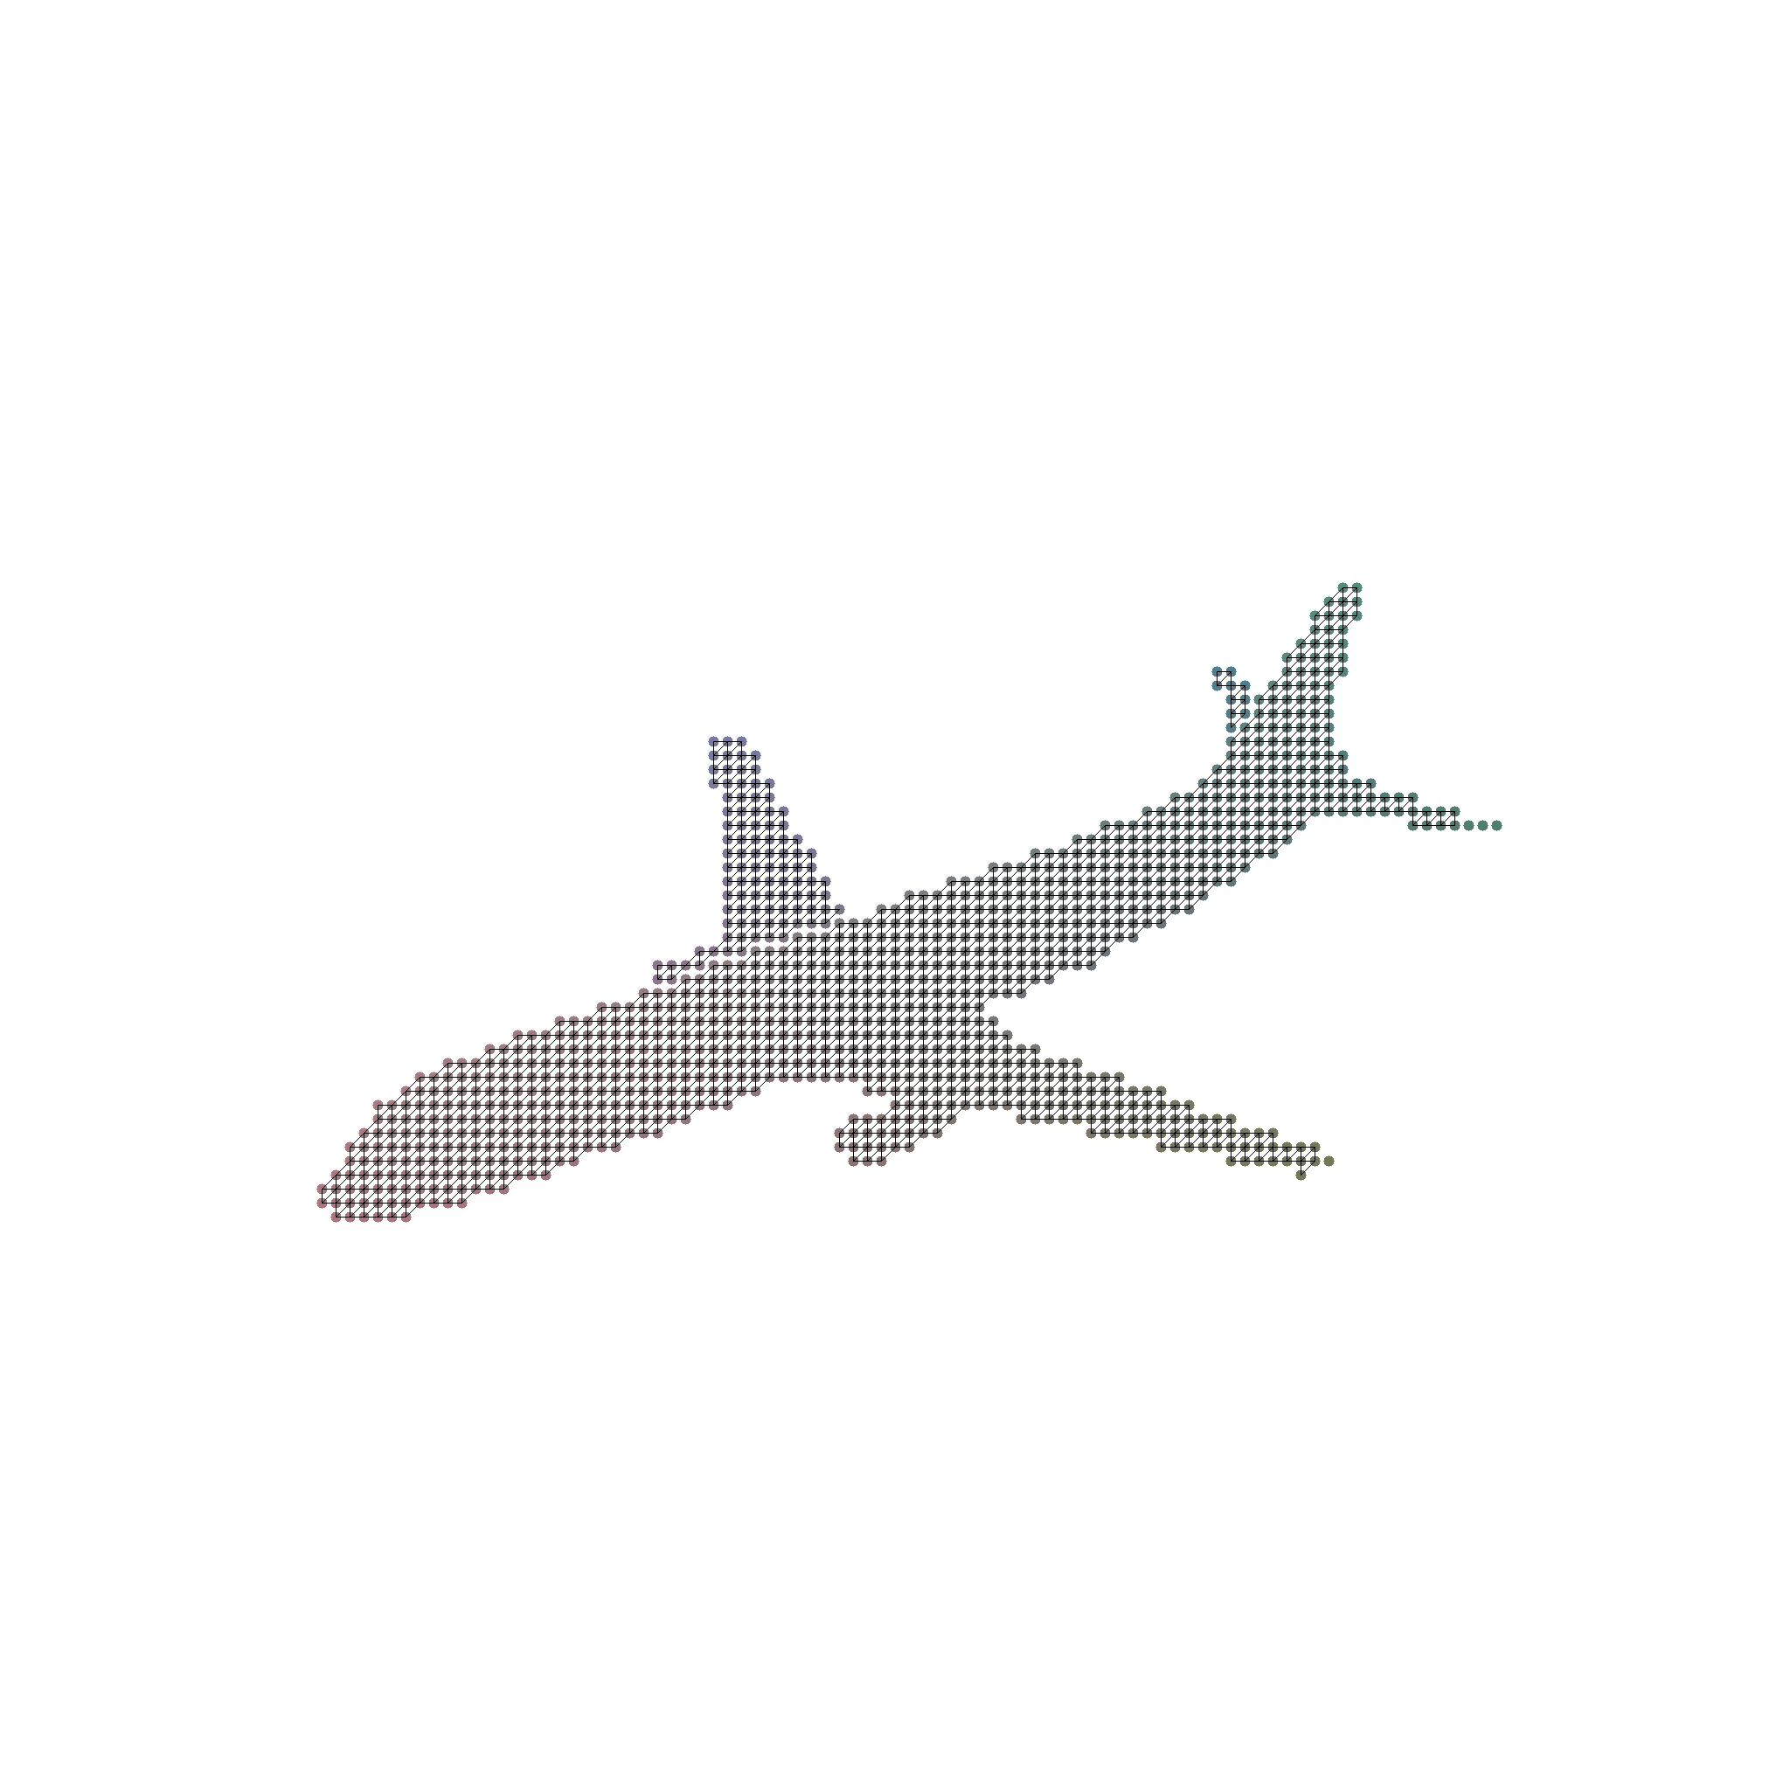

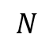
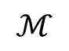
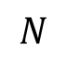
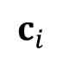
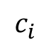

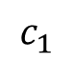
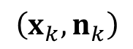
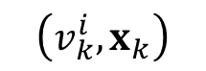
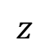

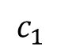
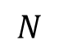
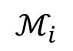
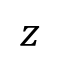
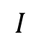
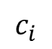
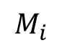
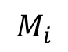
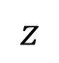
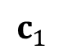
Multi-View Point Networks
Encoder
Decoder
$$\left(v_{k}^{i},x_{k}\right)$$
$$M_{i}$$
$$I$$
$$ℳ_{i}$$
$$z$$
$$\left(x_{k},n_{k}\right)$$
$$z$$
Parameterize
$$ℳ$$
$$c_{i}$$
Triangulate
Instantialize
$$c_{i}$$
$$M_{i}$$
$$c_{i}$$
$$N$$
Share weights
$$N$$
$$z$$
$$N$$
$$c_{1}$$
$$c_{1}$$
$$c_{1}$$

Slide 8
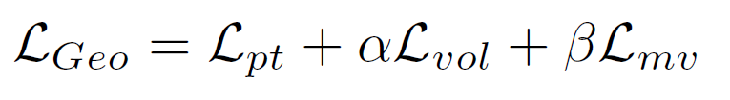
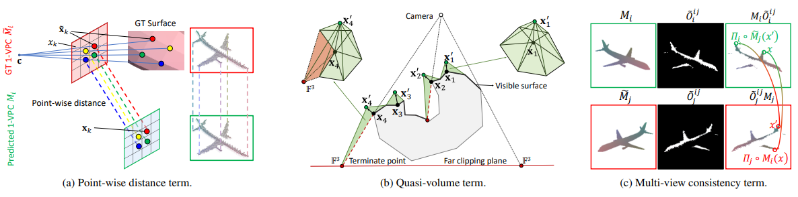


Geometric Loss

Slide 9


Evaluation on ShapeNet Dataset
Table 1. Quantitative comparison to the state-of-the-arts with per-category voxel IoU on ShapeNet dataset.
Table 2. Quantitative comparison to point generation methods using chamfer distance metric on ShapeNet dataset.

Slide 10

Results on ShapeNet Dataset (Compared to point-based method)
Thin structure
Concave structure

Slide 11

Results on ShapeNet dataset (Compared to voxel-based method)
Thin structure
Concave structure
Thin structure

Slide 12











Results on Real Data
chair
plane
=
=
car

Slide 13
Model Interpolation
Within-Class
Cross-Class

Slide 14
Conclusions
We introduce an efficient and expressive representation, MVPC, for the single view reconstruction problem.
The explicitly encoded one-to-one mapping between points provides efficient loss computation.
The embedded grid structure express local connectivities for 3D mesh construction。
We propose a novel geometric loss that formulates discrepancy over real 3D space rather than 2D projective.
The proposed MVPC allow us to discretize integrals of surface variations over the constructed triangular mesh.
The geometric loss integrating volume variations, prediction confidences and multi-view consistencies contributes to high reconstruction performance.

Slide 15
Thank you!

